Slide 1
Assignment #2
Due 9 PM, 15 March
Objective
To know the basic concepts of Bilinear Rectangle elements.
To know the basic concepts of strain and stress calculations using rectangular elements for plane-stress problems.

Slide 2
Rectangular Plane Element
(Bilinear Rectangles)
The rectangular plane element, also called bilinear rectangle (all interior angles 90°) , is a quadrilateral element with four corner nodes (locally, i-j-m-n or 1-2-3-4, labelled counterclockwise) in a regular shape. The word “bilinear” implies the distribution of displacement within the element is linear along x and y axis. So each element has eight unknown nodal displacements .
4
3
b
b
h
U4
Bilinear Displacement distribution
U3
h
1
2
U1
U2

Slide 3
the displacement {u} at any interior point of an element is interpolated in terms of the shape functions [N] and the nodal displacements {d} as:
4
3
1
2
So far, we have obtained the general displacement representation for any point inside an element using the shape functions and nodal displacements. Then, based on the fundamentals of elasticity, we can get the strain-displacement and stress-strain relationships, and derive the element stiffness matrix and finite element equations.

Slide 4
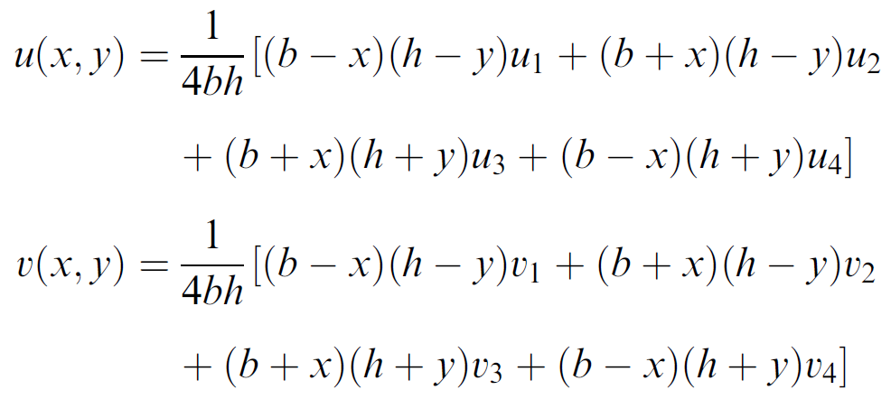
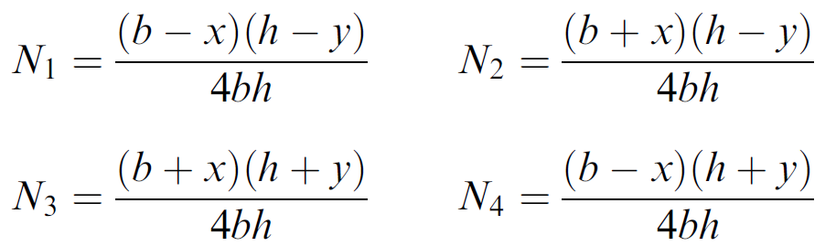
In use bi-linear interpolation functions, we have the approximation:
Thus, the shape functions are defined as,

Slide 5
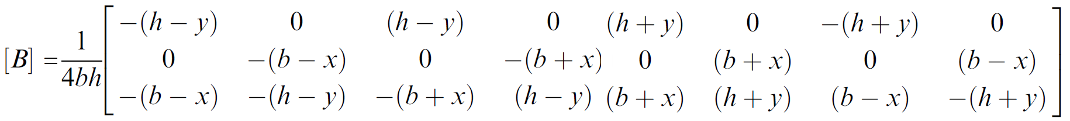
2. Define Strain-Displacement Relationship
For 2D problems, the three strains (two normal strains; one engineering shear strain) are defined in terms of the derivatives of the displacements u and v with respect to x and y coordinates.
Linear-strain distribution within a bilinear rectangle element

Slide 6
Problem #2
In the Assignment #1, we used bi-linear rectangular elements in the FEM analysis of the given structure.
For the same problem, use and modify your Matlab program and calculate the following:
Strain at each node position, and stress at each node position.
Observe the calculated strain and stress at the nodes which are shared by two adjacent elements. When the calculations are carried out from the adjacent elements respectively, are the obtained strain (stress) results equal at the shared nodes? Why or why not?
Calculate the von Mises strain at the centre of each element and make a colour plot of the strain.
Calculate the von Mises stress at the centre of each element and make a colour plot of the stress.

